Slide 1
Task Management System
Project Presentation

Slide 2
Speaker
Mahafuj Ahamed
ID: 221-15-5448
Section: 61_A
Department of CSE
Daffodil International University

Slide 3
Contents
Diagram
One
Introduction
Two
Objectives
Methodology
Four
Three
Five
Conclusion

Slide 4
Introduction
This system empowers you to gain clarity by listing all tasks, prioritize them effectively, schedule time for each, and track your progress. With TMS, you can boost productivity, reduce stress, and achieve your goals by streamlining your workflow and maintaining a healthy work-life balance.

Slide 5
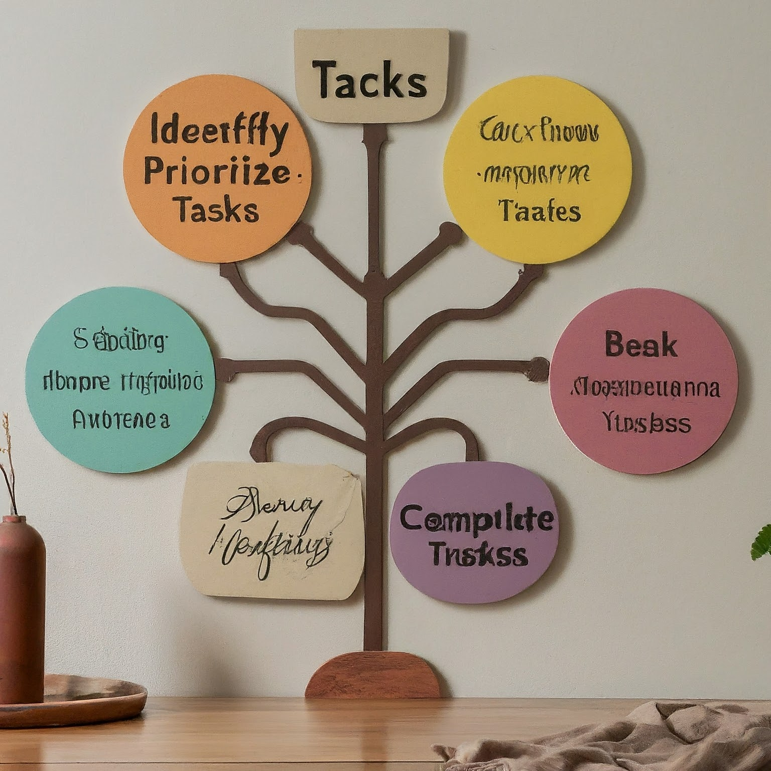
Enhance organization and task clarity Improve prioritization and time management Streamline workflow and increase efficiency Boost productivity and achieve goals Reduce stress and promote work-life balance
Objectives
Workflow

Slide 6
Methodology
Language
OOP Approach
Contents
Programming Language: Python
Modularity: Breaks down the system into well-defined and reusable components.
Encapsulation: Protects data integrity by restricting direct access to internal attributes.
Inheritance: Allows for creating specialized task types ( meeting, phone call) inheriting general properties from the base Task class.
Maintainability: Makes the code easier to understand, modify, and extend.
Task Identification
Task Prioritization
Task Scheduling
Task Tracking & Monitoring

Slide 7
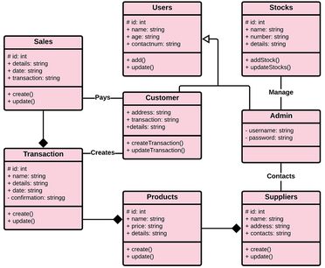
Class Diagram
15 weeks
25 weeks

Slide 8
Task Management System offers a valuable tool to empower you and those around you. Embrace this system as a strategic partner on your path to success, allowing you to conquer your day and unlock your full potential.
Conclusion

Slide 9
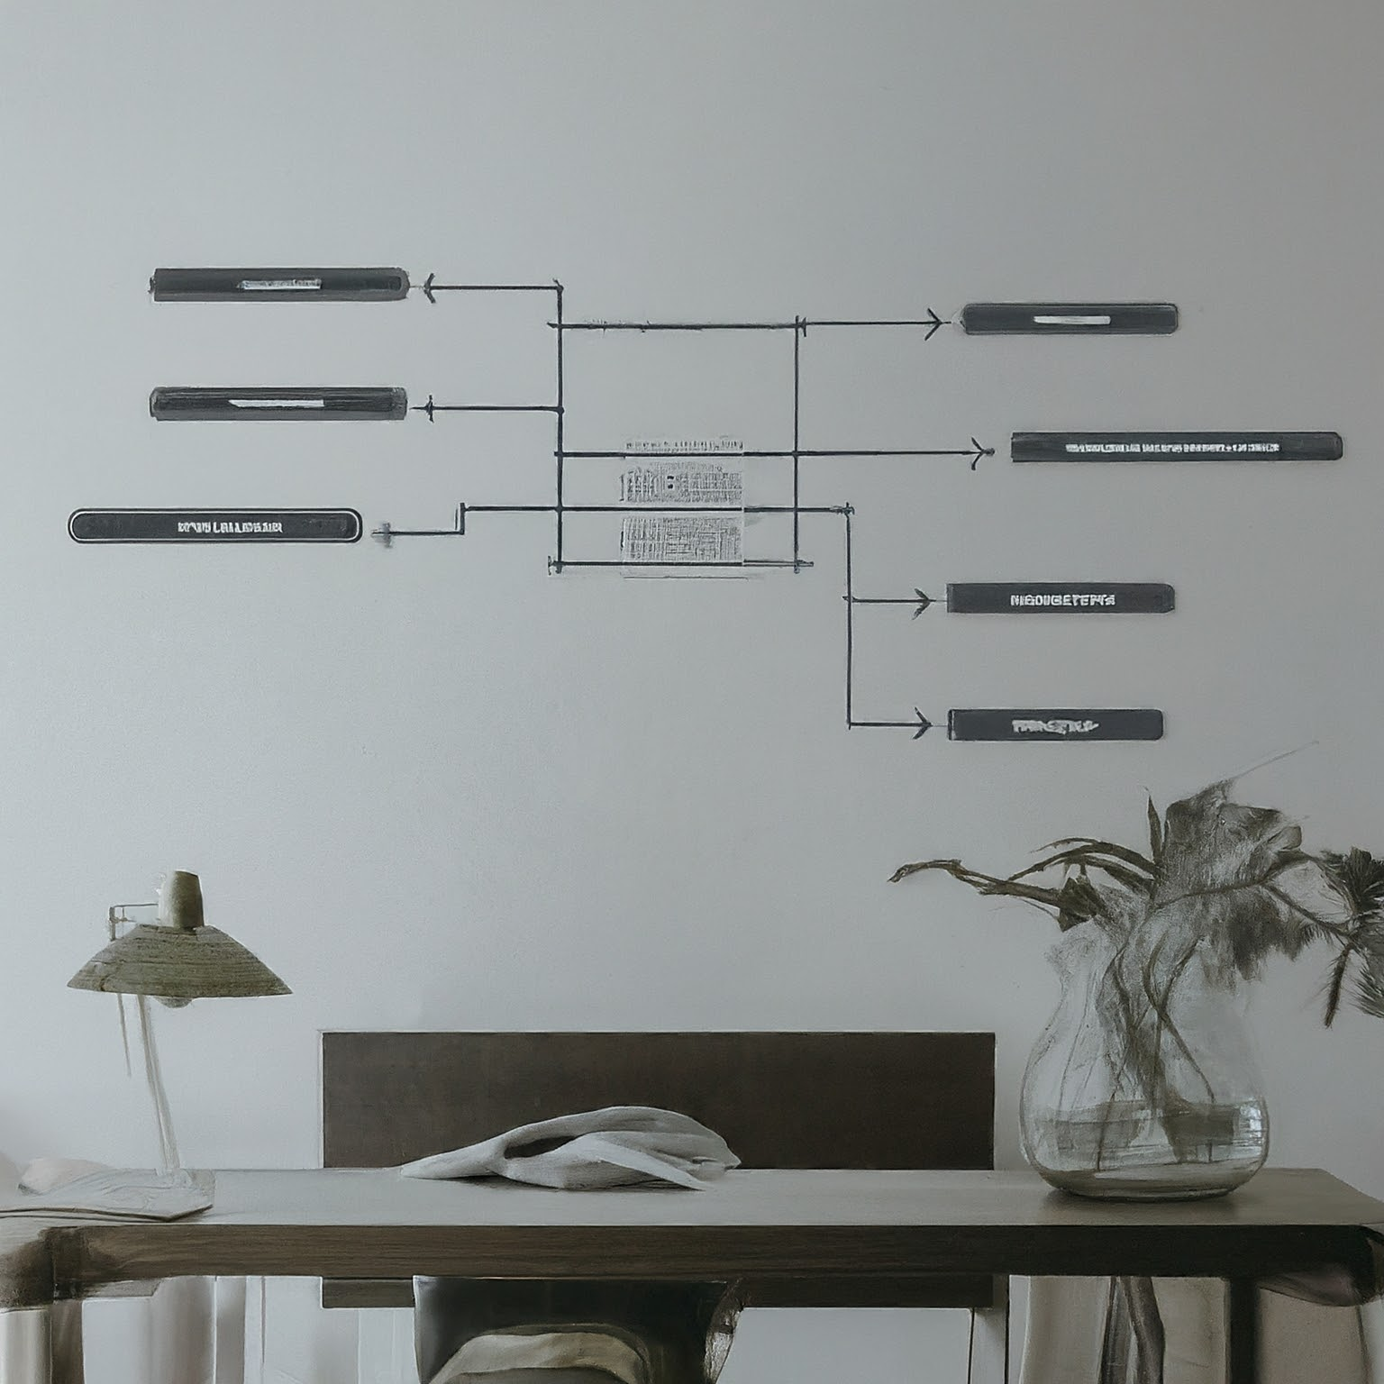
Thank you

